Slide 1
Pointers – Why?
A way to store a “reference” to an object
A way to store large amounts of information not associated with a function (the heap)
A way to link objects together

Slide 2
What it looks like
In C++ a pointer must specify the datatype that it points to
In main memory, the pointer is simply a stored number
The stored number represents the memory address of the item being pointed to

Slide 3

Getting pointers to point
Pointers can be made to point to something
The address of the item being pointed to is stored in the pointer.
We can get the address of an item by using the “address-of” operator, the ampersand “&”, in front of the variable’s name.

Slide 4
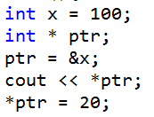
Accessing data from a pointer
Pointers would be pretty useless if all they could do was point.
We can access the data that a pointer is pointing to by “dereferencing” the pointer. We do this using the dereferencing operator, the star “*”.

Slide 5
What if a pointer doesn’t point to anything?
Pointers always point to something
If the pointer isn’t pointing to something VALID, it should point to:
NULL or nullptr

Slide 6

Defining multiple pointers
When defining pointers, the * is associated with only the next item in the sequence. If you need multiple pointers in the same line, you need more stars!

Slide 7
Lets get dynamic!
Pointers wouldn’t be much use if they could only point to objects that were created already!
Pointers can point to heap-dynamic memory!
Heap-Dynamic memory is allocated when you ask for it, and remains allocated until you destroy it.
This means it can survive function calls!
You have to be very careful to destroy it after you’re done, it’s not destroyed automatically.

Slide 8

Well, that’s new
A variable can be created on the heap for a particular datatype, but it does not have a name.
If it doesn’t have a name, how do you refer to it? …pointers!
Once memory is allocated on the heap, it will not be deallocated until you do it, or the program ends.
If you lose track of a head-dynamic variable, it becomes “garbage on the heap” aka, a “memory-leak.”

Slide 9
For every new, there must be delete
If memory is allocated, it must be destroyed.
You must destroy it once and only once
Forgetting to destroy it results in a memory leak
Deleting it twice results in a “double delete,” which will crash your program
Deleting NULL or nullptr has no effect.

Slide 10
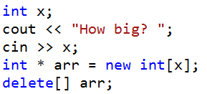
What about arrays?
Heap-dynamic arrays don’t have to have a static size!
Once created, heap-dynamic arrays can’t grow, but they can be created to be any size initially.
Since we are working with a pointer, a new, larger, heap-dynamic array can be made to replace a smaller one!
Deleting a heap-dynamic array is a bit different

Slide 11
What can we do with heap-dynamic arrays
Heap-dynamic arrays are no different than the “normal” arrays which you’ve been using.
Use heap-dynamic arrays just like all other arrays, using the square-brackets operator.
You can also use pointer arithmetic…

Slide 12
Pointer arithmetic
C++ allows pointers to be manipulated using simple math operations.
Use the addition operator (“+”) to move the pointer forward some number of spaces (x =x+5 will make the pointer point to 5 elements higher in the array)
Use the subtraction operator to move the pointer backwards
Use ++ or – as you’d like.

Slide 13
A real-example of a growing array
(Laura, I need to insert a screen capture video here)

Slide 14
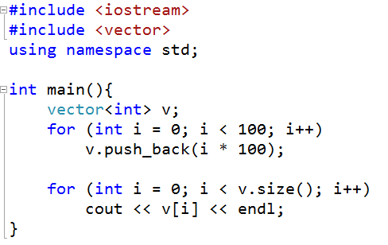
Someone’s done this already
Of course, C++ has something called the “Standard Template Library.”
The STL contains a data-type known as a “vector.”
A vector is a dynamically growing array, in which you don’t need to worry about the size, it will even tell you how many items are in it.

Slide 15
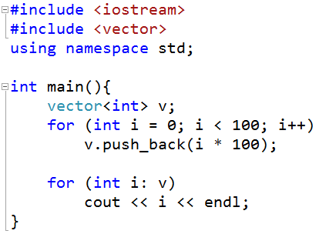
But wait… there’s more!
Vectors allow us to access all of the elements by using a “ranged for loop”
The syntax is a bit strange (it was borrowed from another language and brought into C++ later)

